Slide 1
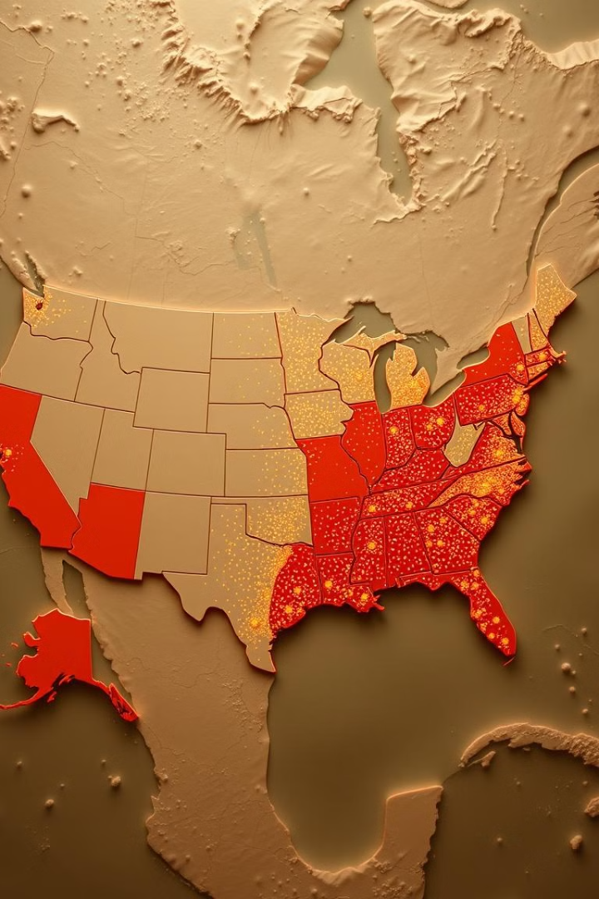

Improving Healthcare Access in Rural and Underserved Areas
Addressing key challenges and solutions to ensure equitable healthcare access for all.
by Student

Slide 2

Introduction
Millions in rural areas face barriers to healthcare access.
Problem Statement
Millions in rural and underserved regions face barriers to healthcare access.
Objective
Identify key issues and propose solutions to improve healthcare access in rural and underserved areas.

Slide 3
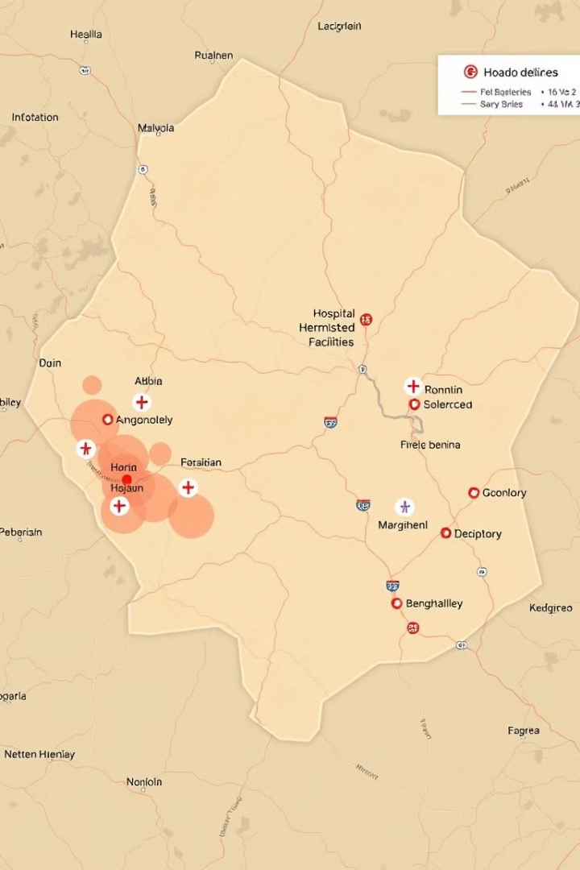
Limited Access to Healthcare Facilities
Lack of nearby healthcare facilities forces long travel distances.
1
Long Travel Distances
Lack of nearby facilities forces long travel distances, impacting access to care.
2
Delayed Diagnosis & Treatment
Long distances result in delayed diagnosis and treatment, affecting patient outcomes.
3
Data on Travel Distances
Examples of increased travel distances following rural hospital closures.

Slide 4
Healthcare Workforce Shortages
Shortage of healthcare professionals affects patient outcomes.
Key Point
Impact
Solution
Shortage of healthcare professionals, especially doctors and nurses, impacting rural areas.
Growing health demands cannot be met, affecting patient outcomes.
Expanding the role of nurse practitioners and utilizing telehealth to improve access to care.

Slide 5

Inadequate Infrastructure
Lack of medical equipment and sanitation affects quality of care.
1
Medical Equipment & Medications
2
Sanitation
3
Examples
Inadequate sanitation and infrastructure contribute to higher health risks and lower quality of care.
Poor infrastructure in rural hospitals, with limited resources and outdated technology.
Lack of essential medical equipment and medications limits access to vital care.

Slide 6

Preventable Diseases & Mortality
High rates of preventable diseases due to lack of timely healthcare.
Preventable Diseases
Impact
Maternal Mortality
High rates in rural areas due to limited access to prenatal care.
Diabetes & Hypertension
Lack of timely diagnosis and treatment can lead to complications and long-term health issues.

Slide 7




Data Gaps for Effective Decision Making
Lack of reliable data hinders policy decisions and resource allocation.
Lack of Reliable Data
Insufficient or unreliable data hinders effective policy decisions.
Inefficient Healthcare Delivery Systems
Poor data leads to inefficient healthcare delivery systems and resource allocation.
Solution: Real-Time Data Systems
Implementation of real-time data collection systems to improve data accuracy and inform decision making.

Slide 8



The Role of Technology in Bridging the Gap
Telehealth and mobile health units address challenges in healthcare access.
Virtual Appointments
Telehealth enables virtual consultations, improving access to specialists and remote care.
Mobile Health Units
Mobile clinics can provide essential healthcare services to remote and underserved areas.

Slide 9
Proposed Solutions & Policy Recommendations
Comprehensive strategies are needed to address immediate and systemic issues in healthcare access.
Short-Term Solutions
Long-Term Solutions
Policy Example
Increase telehealth infrastructure and expand mobile health units.
Incentivize healthcare professionals to work in rural areas and invest in infrastructure.
Loan forgiveness programs for healthcare professionals working in underserved areas.

Slide 10

Conclusion & Call to Action
Collaboration between governments, private sectors, and communities to ensure equitable healthcare access for all.
1
Key Takeaway
Comprehensive strategies are needed to address both immediate and systemic issues in healthcare access.
2
Next Steps
Collaboration between governments, private sectors, and communities is essential to ensure equitable healthcare access for all.

